Slide 1
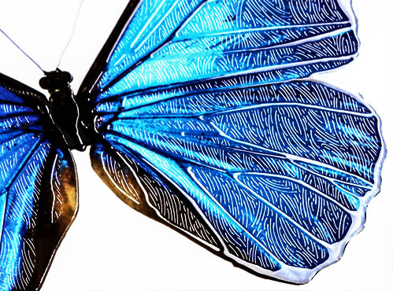
Guide to Creating Mask Files
in Adobe InDesign

Slide 2
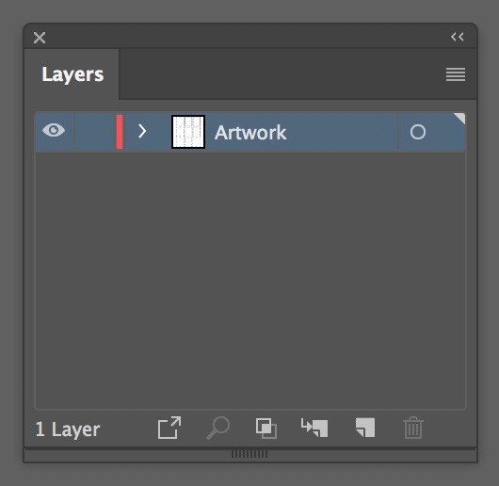
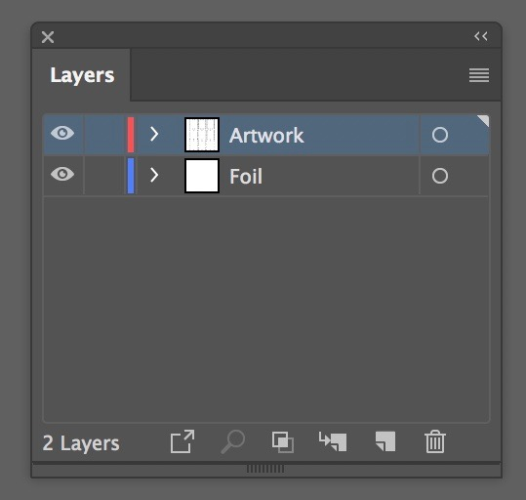
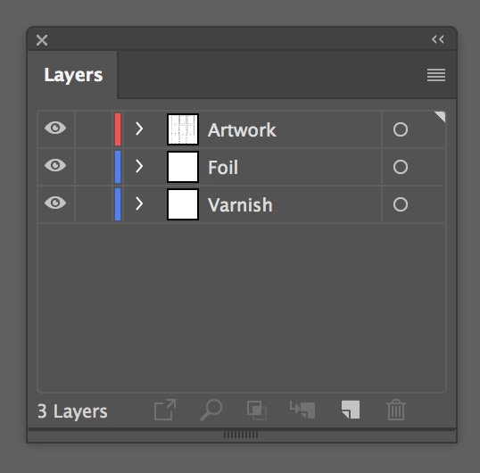
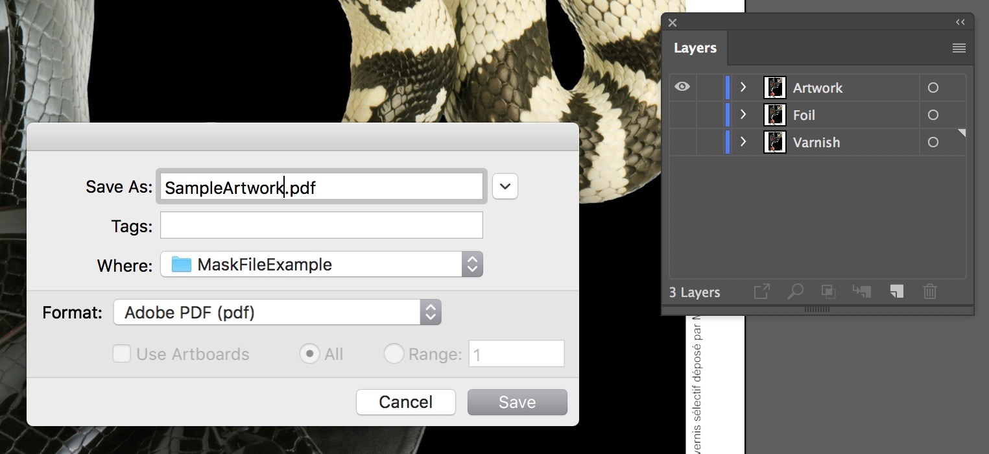
How to Create a Mask File in Adobe InDesign
InDesign Foil and Varnish Mask Creation
In Adobe InDesign, create your design (vector or raster images) on a layer and name it “Artwork”. Raster Images that are used should be saved as .tiff (360 dpi) format before importing them into Illustrator or InDesign.
Duplicate a second layer and label it “FOIL”. In the “FOIL” layer, create areas of 100% Black (K). This is the layer that will have the spot foil. In order to ensure registration please make sure all layers are perfectly aligned with the “Artwork” layer.
Duplicate a third layer and label it “Varnish”. In the “Varnish” layer, create areas of 100% Black (K). This is the layer that will have the spot Varnish highlights. In order to ensure registration please make sure all layers are perfectly aligned with the Artwork layer.
Turn off the “FOIL” and “Varnish” layers, so that only the “Artwork” layer is visible. Save or export your file as a PDF. (Do not flatten the PDF).

Slide 3
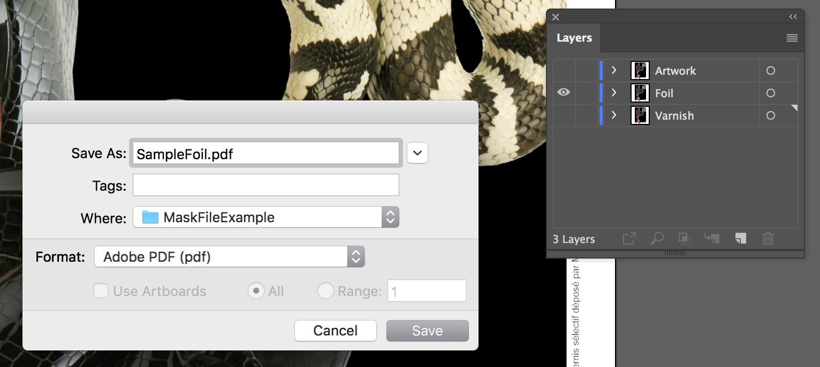
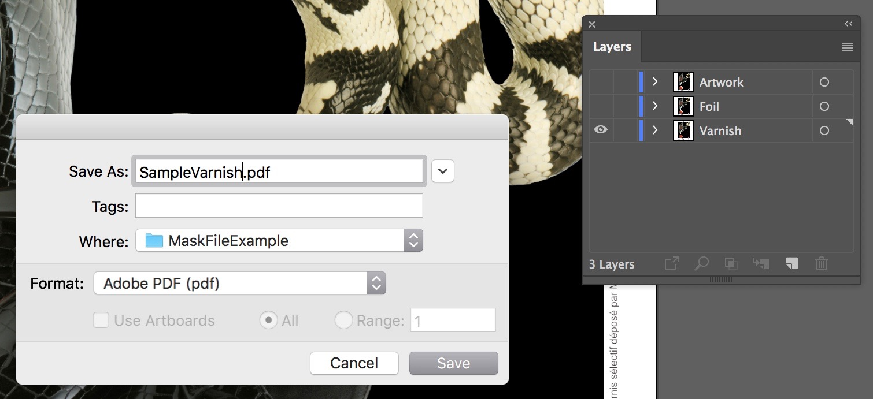
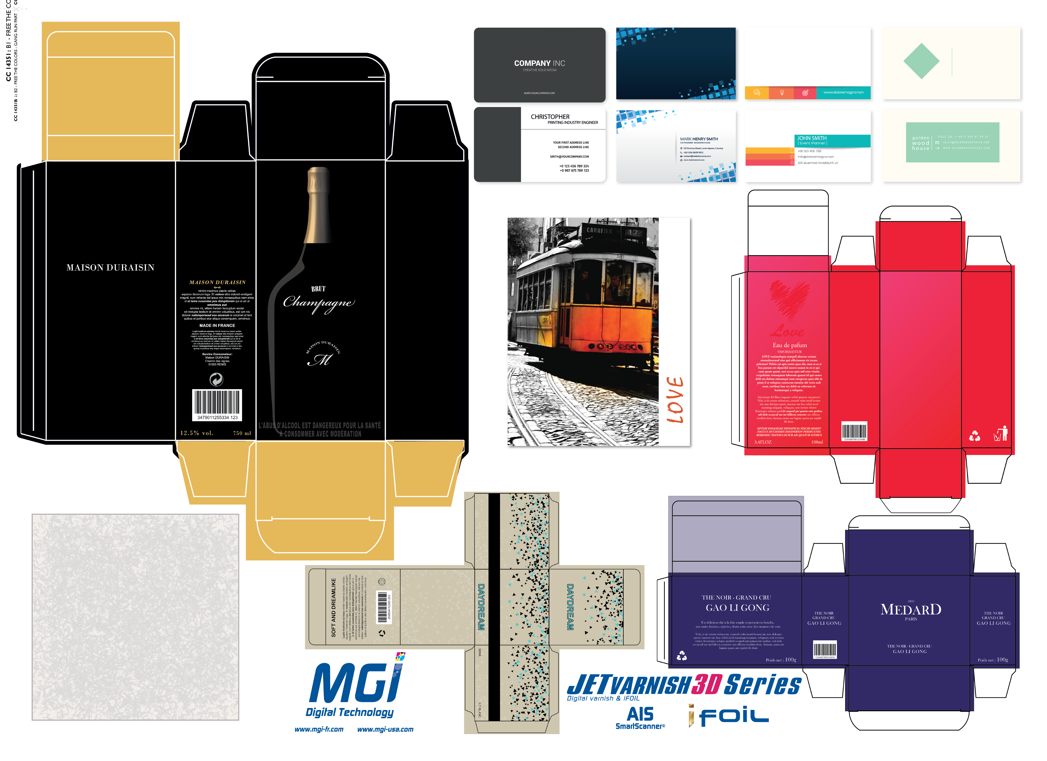
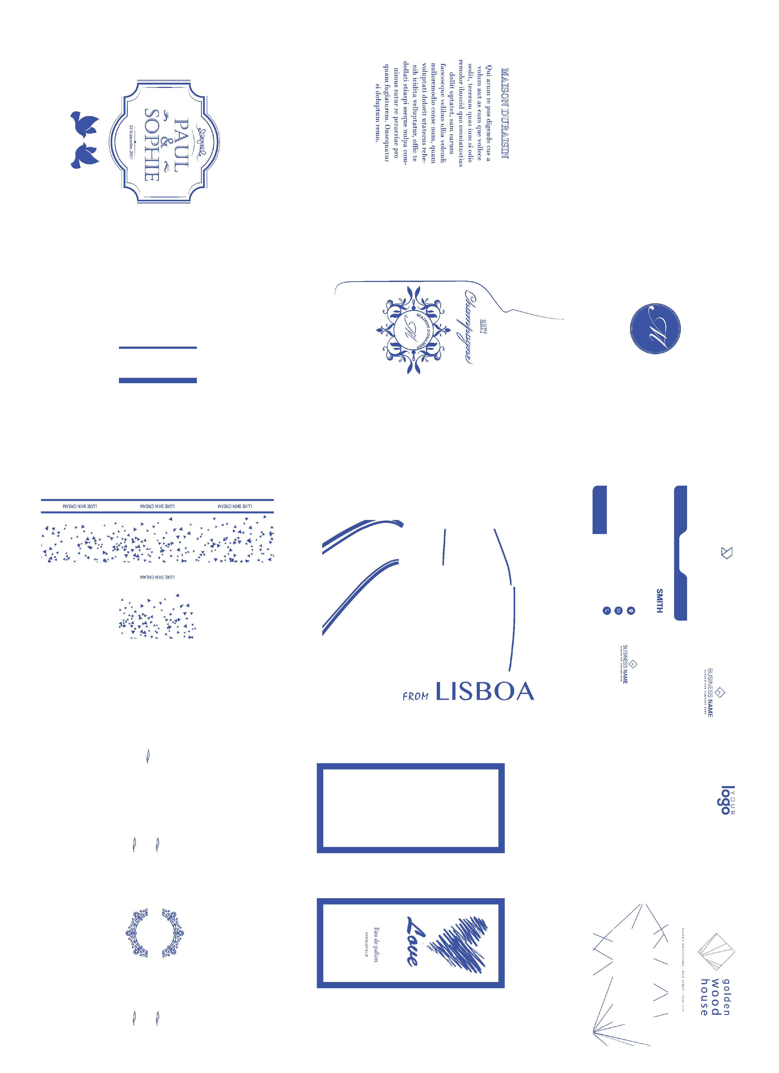
How to Create a Mask File in Adobe InDesign (Continued)
Turn off the “Artwork” and “Varnish” layers, so that only the “Foil” layer is visible. Save or export your file as a PDF. (Do not flatten the PDF).
Turn off the “Artwork” and “Foil” layers, so that only the “Varnish” layer is visible. Save or export you file as a PDF. (Do not flatten the PDF).
You now have 3 PDF files with identical size dimensions, so when the files are laid Out for printing, they will line up perfectly.
Artwork FOIL Varnish
Note: The Mask files are in color to show the differences between FOIL and Varnish. The FOIL and Varnish images MUST display as 100% Black.

