Slide 1
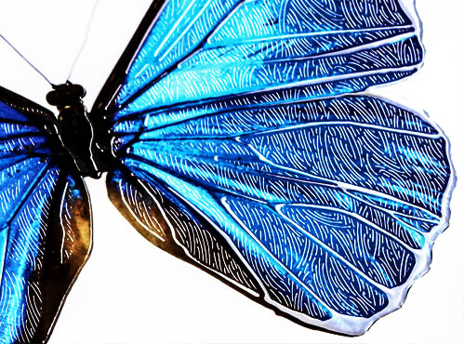
Guide to Creating Mask Files
in Adobe Photoshop

Slide 2
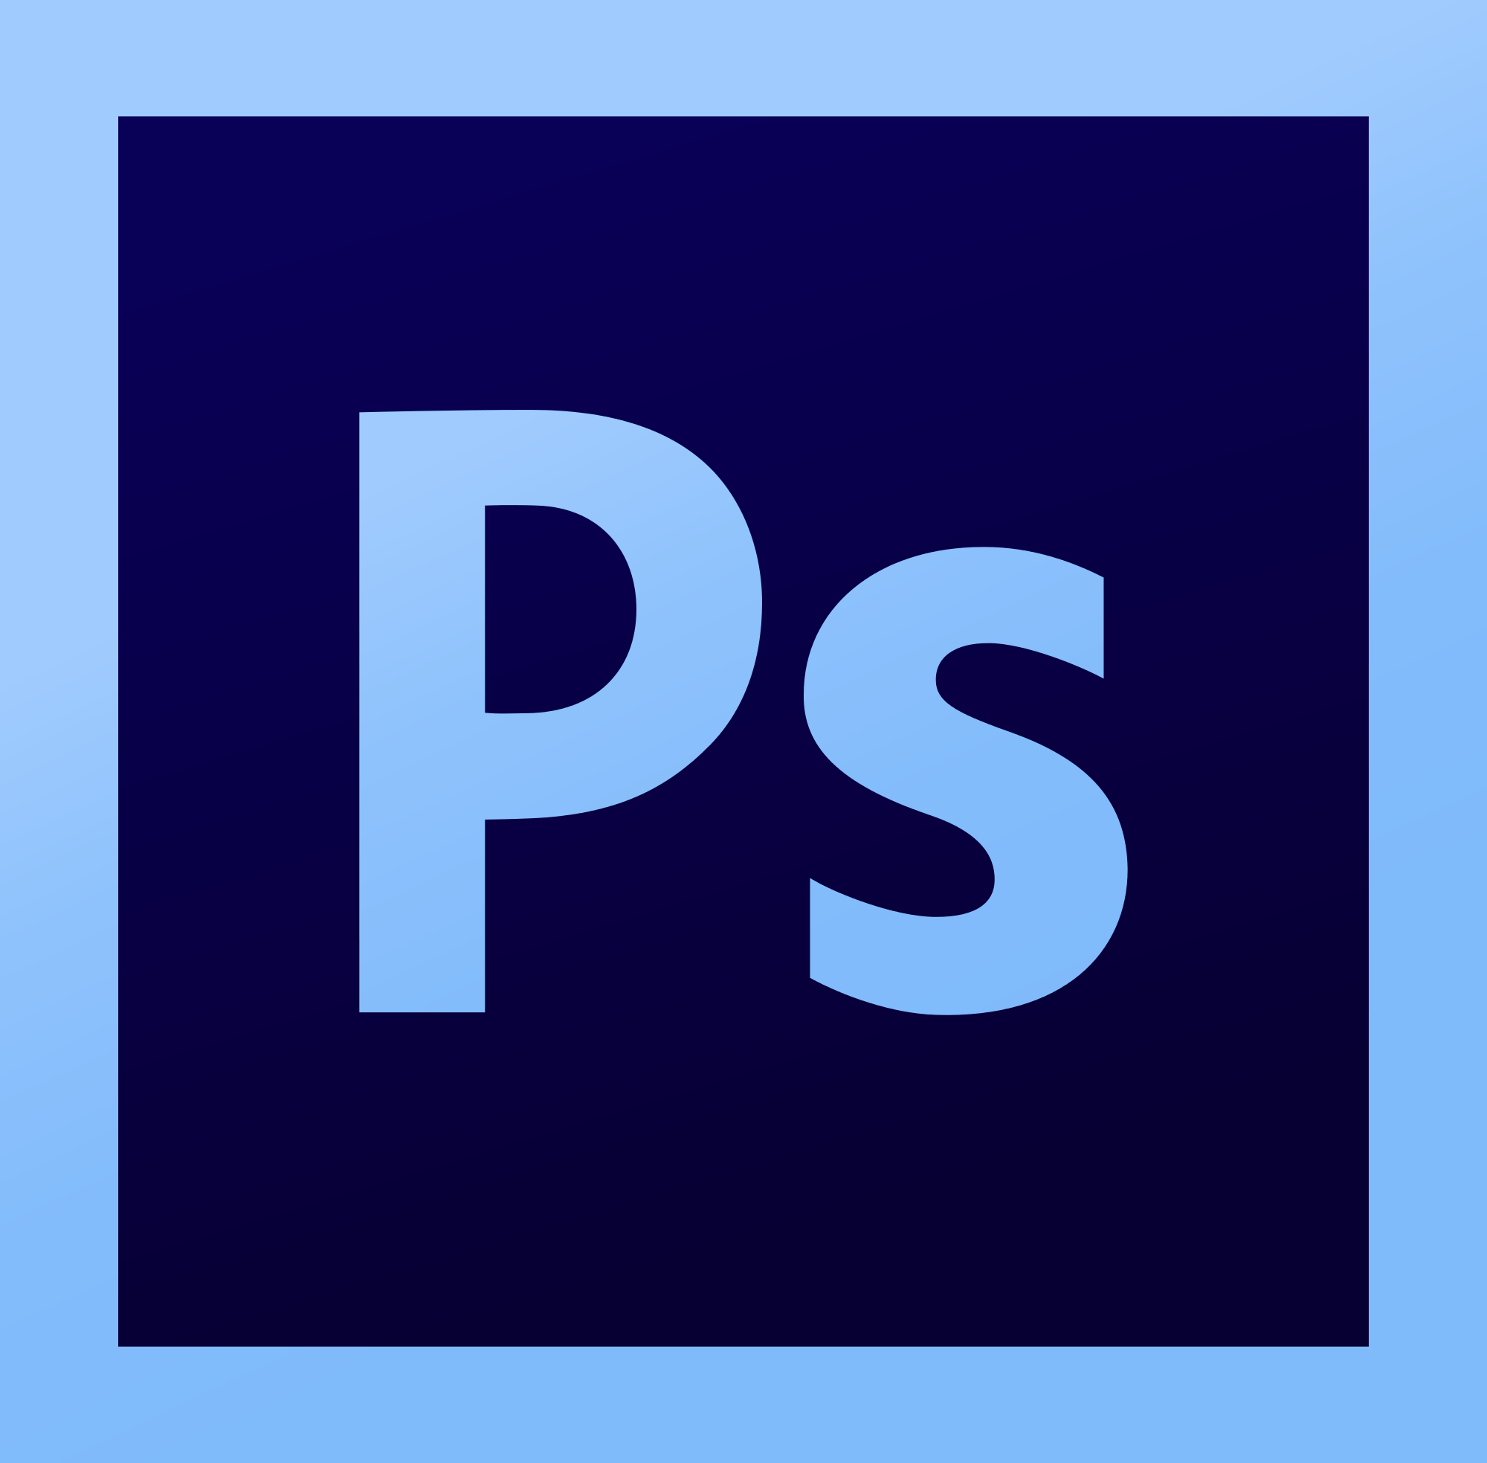
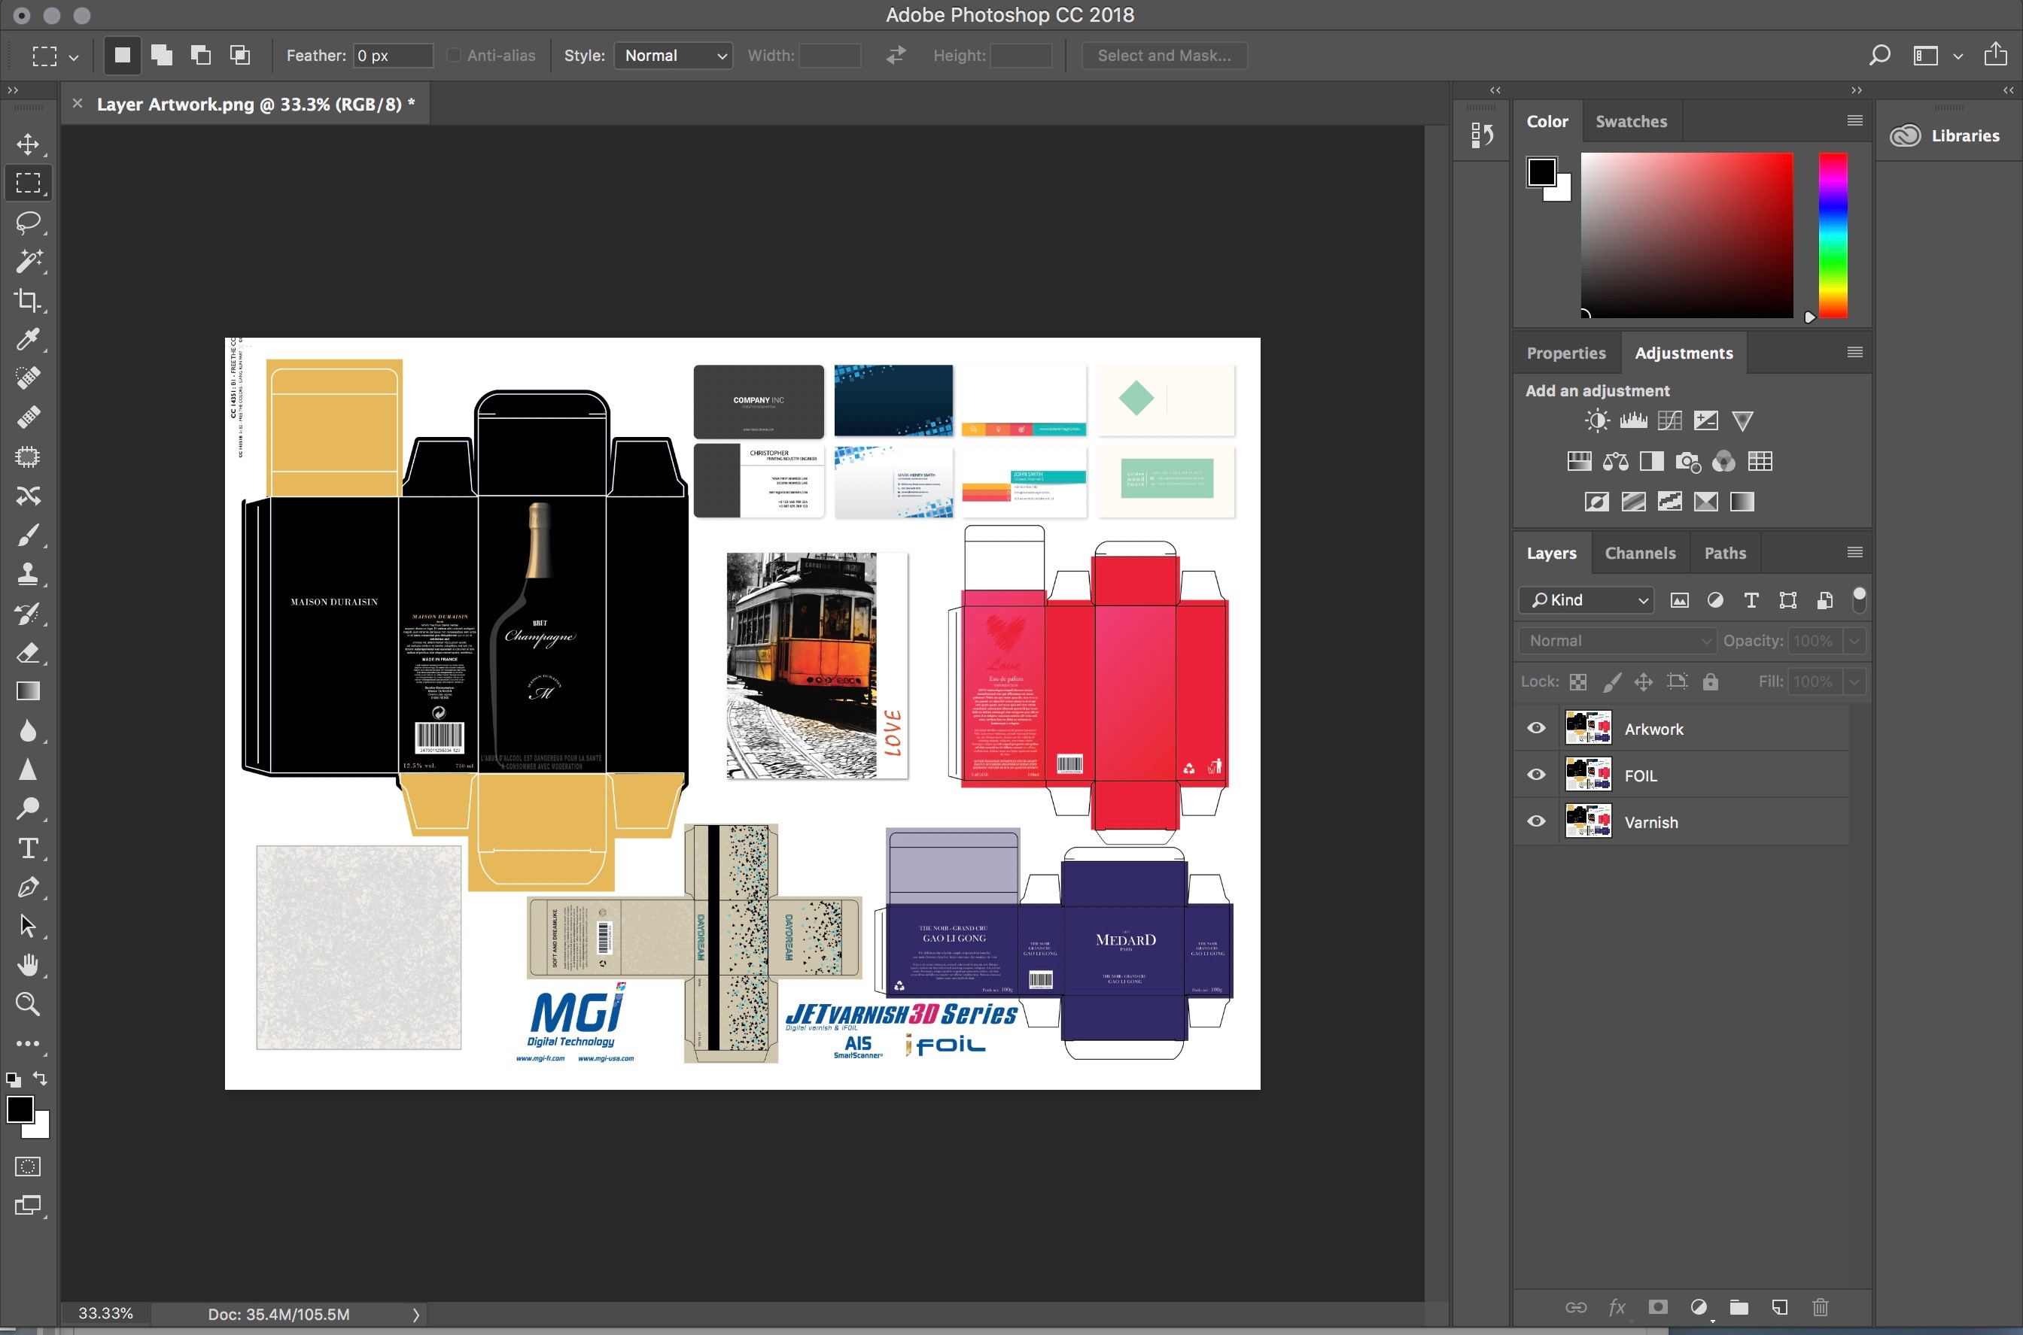
How to Create a Mask File in Photoshop
Photoshop Foil and Varnish Mask Creation
1. In Adobe Photoshop, create your design (vector images)
on a layer and name it “Artwork”. Images that are used should be
saved as .tiff (360 dpi) format before importing them into Photoshop.
Note: Make sure your file is set to CYMK color space. The sheet size should be the same as the printed page size.
2. Duplicate a second layer and label it “Varnish”. In the “Varnish” layer,
create areas of 100% Black (K). This is the layer that will have the spot
Varnish highlights. In order to ensure registration please make sure all
layers are perfectly aligned with the Artwork layer.
3. Duplicate a third layer and label it “Foil”. In the “Foil” layer, create areas
of 100% Black (K). This is the layer that will have the spot Varnish highlights.
In order to ensure registration please make sure all layers are perfectly
aligned with the Artwork layer.

Slide 3
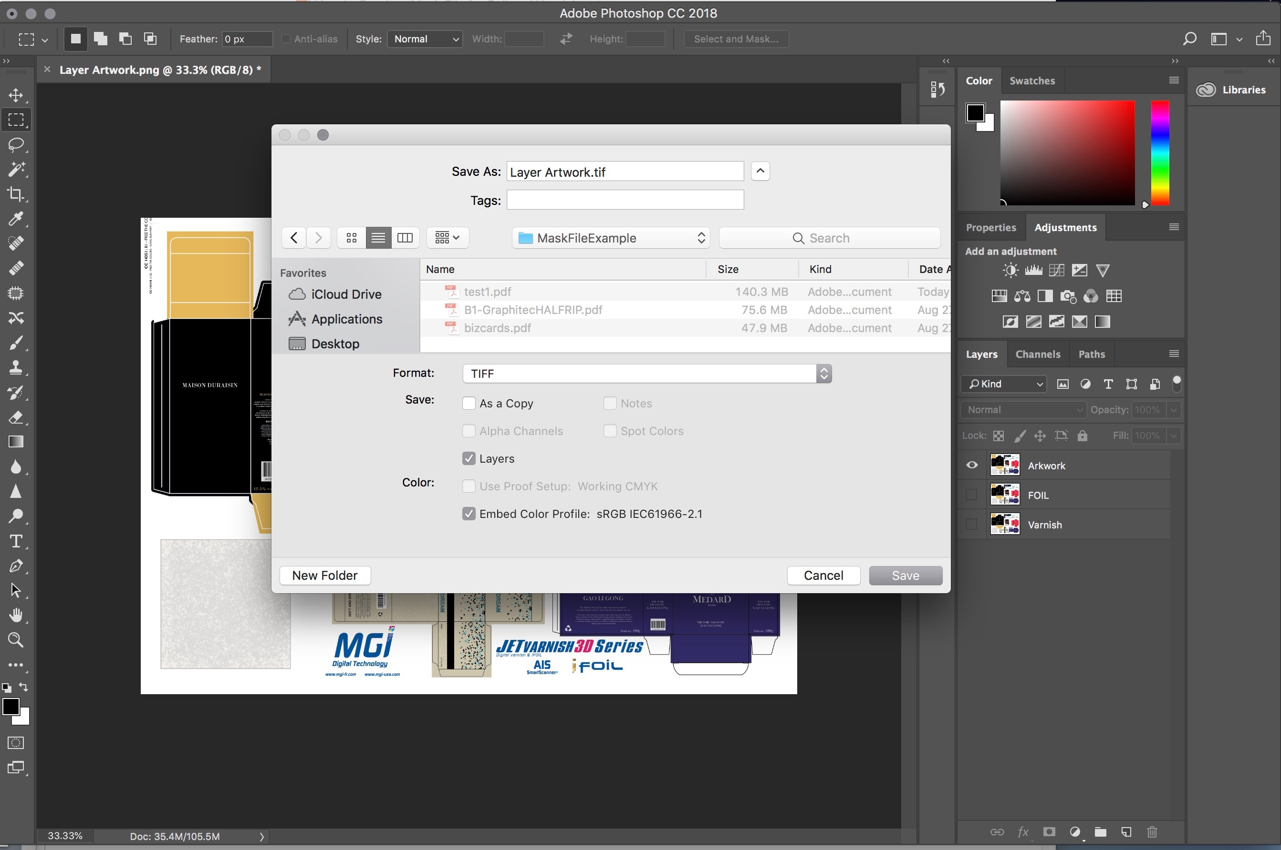
How to Create a Mask File in Photoshop (Continued)
4. Turn off the “FOIL” and “Varnish” layers, so that only the “Artwork” layer is
visible. Save file as a .tif. (Save as NameArtwork.tiff) (Must be saved as 360 dpi
grayscale 8 bit .tif).
5. Turn off the “Artwork” and “Varnish” layers, so that only the “Foil” layer is
visible. Change the document color setting to “Grayscale”. Merge the layer
when prompted. Set the image to 360dpi with out altering the document size.
Save your file as a tiff. (Save as NameFoil.tif). (Must be saved as 360 dpi
grayscale 8 bit .tif).
6. Turn off the “Artwork” and “Foil” layers, so that only the “Varnish” layer is
visible. Change the document color setting to “Grayscale”. Merge the layer
when prompted. Set the image to 360dpi with out altering the document size.
Save your file as a tiff. (Save as NameVarnish.tif). (Must be saved as 360 dpi
grayscale 8 bit .tif).
You will now have three .tif files with identical size dimensions, so that when the files are laid out for print, they all perfectly line up. Note: The Artwork, FOIL, and
Varnish layers can also be saved as an Adobe PDF format.

